Slide 1
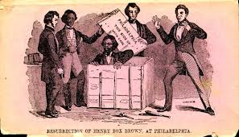
Rethinking the Black Freedom Movement:
The Box Lectures
Abdul Alkalimat
Department of African American Studies
University of Illinois Urbana-Champaign
September 11, 2012

Slide 2
2011
Rethinking Theory in Black Studies

Slide 3
2011
Rethinking Malcolm X

Slide 4
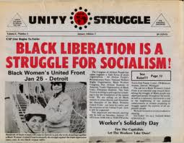
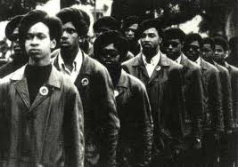
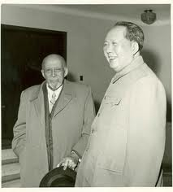
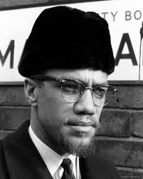
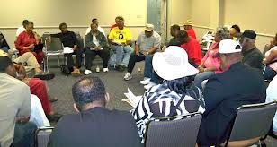
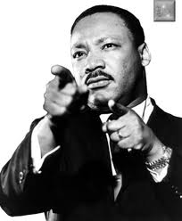
2012
Rethinking Black Freedom

Slide 5
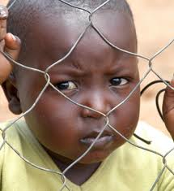
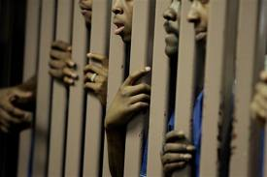
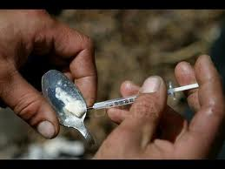
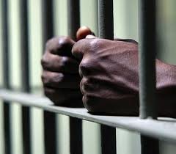
The Box Lectures
9/11 The Box
10/2 In the Box
10/23 Out the Box
11/13 New Box
12/4 No Box
2012

Slide 6
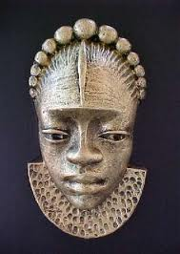
What is a box?
A box is what limits freedom.
So what is freedom?
Freedom is without the limits of a box.

Slide 7
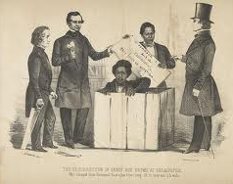
Henry “Box” Brown
1815 – 1889
He shipped himself
from the slave state
of Virginia to the free
city of Philadelphia
in March 1849. He
was 34 years old.
When Brown was released, one of those present remembered
his first words as "How do you do, gentlemen?" He then sang
a psalm from the Bible he had previously selected for his
moment of freedom. But he then had to run from more boxes.

Slide 8
Translation
The Box: the conditions that have always been forced on Black people because of racism and economic exploitation, especially by the government and the corporations in different historical periods.
In the Box: The Civil Rights Movement fighting to integrate into the society within the framework of the Constitution.
Out the Box: The Black Nationalist and Pan-Africanist Movements that focus on the autonomous self-determination strategies for Black people. There is also the tradition of migrations, moving out.
New Box: Revolutionaries of all kinds who fight to transform society,
usually from capitalist oligarchy to socialist democracy.
No Box: Given the information revolution there is a new beginning,
but we also face the digital divide – can we escape boxes?

Slide 9
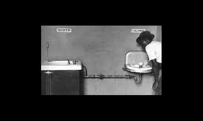
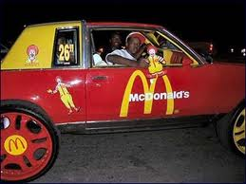
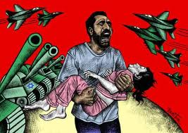
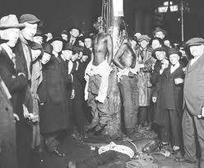
Humans are born into many boxes simultaneously.
Sometimes boxes are positive and provide a nurturing
environment and sometimes not. But that’s where we
all begin - in boxes.
Gender
Color
Family
Neighborhood
Community
School
Church
Job
Nationality
Size and shape
Hair
Year born
None of us are free. The only choice we have is what we do about the boxes.

Slide 10
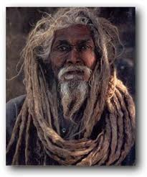
Modes of
Social cohesion
Africa
Slavery
Rural
Urban
Information
Modes of
Social disruption
Slave trade
Emancipation
Great migrations
Crisis
F
r
e
e
d
o
m
‘s
M
u
s
I
c
Black boxes of cohesion have faced multiple disruptions

Slide 11
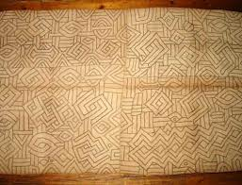
Theory of the
four forms of freedom
Consciousness
Individual acts
Sub-cultures
Movements for social change

Slide 12
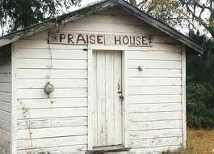
Consciousness:
the language, ideology
and rituals of freedom
We spoke in tongues and made
music rhythms to old testament
stories of wars of freedom.
Emancipation debate
Self Determination Debate
Black Liberation debate

Slide 13
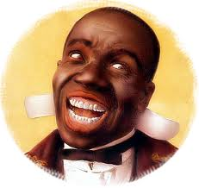
Individual acts:
Self-defense and disrespect
“When the emperor passes, the wise peasant bows and silently farts.”

Slide 14
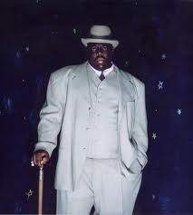
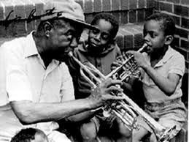
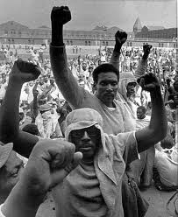
Sub-cultures:
Resistance as political culture
Resistance as political culture
Prison
Jazz
Street life

Slide 15
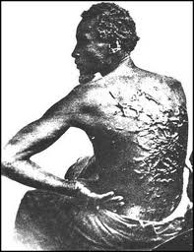
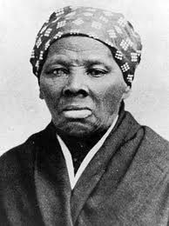
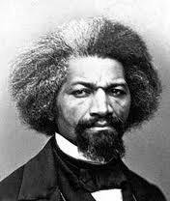
Movements for social change:
To end slavery
Slave Revolts
Abolitionist Movement
Under Ground Railroad
Civil War
Reconstruction

Slide 16
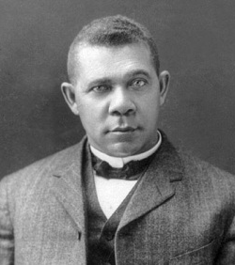
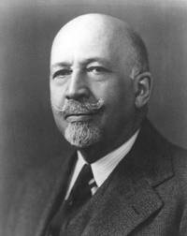
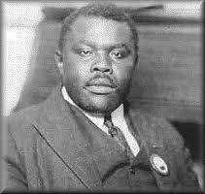
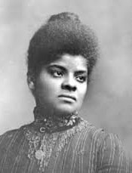
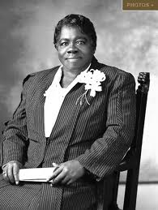
Movements for social change:
To end oppression
UNIA
NAACP
African Blood Brotherhood
Negro Labor Council
Sharecroppers Union
Communist Party
Black Churches
Southern Negro
Youth Congress
National Negro Congress

Slide 17
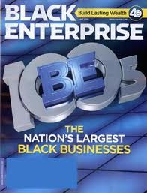
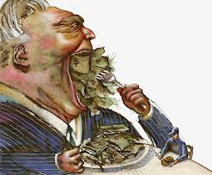
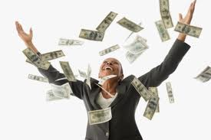
This is a motion to become part of the big box,
the very box most responsible for the exploitation
of Black people, but where a few can get rich.

Slide 18
Dialectics of the
African American Freedom Dance
The integrationist option:
Achieve within the box, and change it
The Nationalist/Pan-Africanist Option:
Leave the box, create an alternative
The Revolutionary option:
Take over the box and transform it
into something new

Slide 19
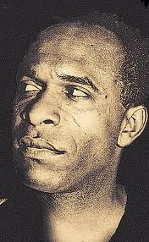
Dialectics of fighting the Box(es)
The assimilationist phase: “In the first phase, the native
intellectual gives proof that he has assimilated the culture
of the occupying power.”
The nationalist phase: In the second phase we find the
native is disturbed; he decides to remember who he is.”
The fighting phase: “Finally…the native…will on the
contrary, shake the people.”
Frantz Fanon
1925 - 1961

Slide 20
IN THE BOX…
1. What are the rules of the box – laws, customs, and structure?
2. What are the degrees of freedom within the box – any wiggle room?
3. What are the rates of success within the box – anybody able to make it?
Are we being polarized within the box
- are all Black people in the same box?

Slide 21
OUT THE BOX…
1. What are the opportunities to migrate
to a better place?
2. What is the role of liberation in Africa
and the African Diaspora?
3. What are viable strategies of
self-determination?
4. What is the difference between leaving
the box and being put out?

Slide 22
NEW BOX…
1. What is the 21st century alternative
to capitalism?
2. How can we end racism and national
oppression?
3. Who hates this system and can they
be united?
4. How much freedom is possible?

Slide 23
In sum…
In
Out
How do you feel about being in the box?
New

